Slide 1
Unsupervised Learning

Slide 2
K-Nearest Neighbor(KNN)
K-Nearest Neighbour is one of the simplest Machine Learning algorithms based on Supervised Learning technique.
K-NN algorithm assumes the similarity between the new case/data and available cases and put the new case into the category that is most similar to the available categories.
K-NN algorithm stores all the available data and classifies a new data point based on the similarity. This means when new data appears then it can be easily classified into a well suite category by using K- NN algorithm.
K-NN algorithm can be used for Regression as well as for Classification but mostly it is used for the Classification problems.
K-NN is a non-parametric algorithm, which means it does not make any assumption on underlying data.

Slide 3
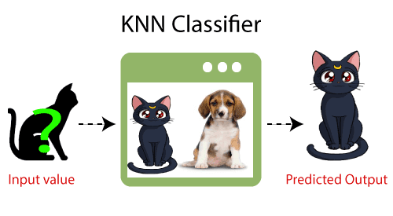
It is also called a lazy learner algorithm because it does not learn from the training set immediately instead it stores the dataset and at the time of classification, it performs an action on the dataset.
KNN algorithm at the training phase just stores the dataset and when it gets new data, then it classifies that data into a category that is much similar to the new data.
Example: Suppose, we have an image of a creature that looks similar to cat and dog, but we want to know either it is a cat or dog. So for this identification, we can use the KNN algorithm, as it works on a similarity measure.
Our KNN model will find the similar features of the new data set to the cats and dogs images and based on the most similar features it will put it in either cat or dog category.

Slide 4
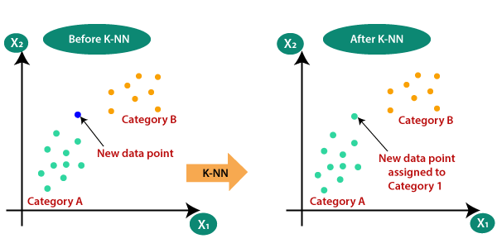
Why do we need a K-NN Algorithm?
Suppose there are two categories, i.e., Category A and Category B, and we have a new data point x1, so this data point will lie in which of these categories.
To solve this type of problem, we need a K-NN algorithm. With the help of K-NN, we can easily identify the category or class of a particular dataset. Consider the below diagram:

Slide 5
How does K-NN work?
The K-NN working can be explained on the basis of the below algorithm:
Step-1: Select the number K of the neighbors
Step-2: Calculate the Euclidean distance of K number of neighbors
Step-3: Take the K nearest neighbors as per the calculated Euclidean distance.
Step-4: Among these k neighbors, count the number of the data points in each category.
Step-5: Assign the new data points to that category for which the number of the neighbor is maximum.
Step-6: Our model is ready.

Slide 6
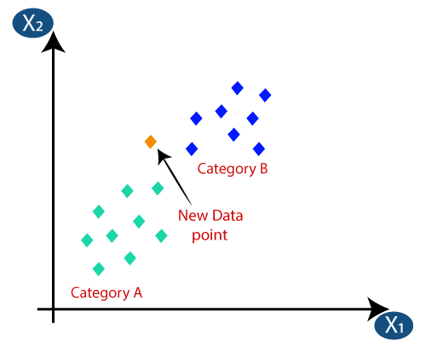
Firstly, we will choose the number of neighbors, so we will choose the k=5.
Next, we will calculate the Euclidean distance between the data points. The Euclidean distance is the distance between two points.
By calculating the Euclidean distance we got the nearest neighbors, as three nearest neighbors in category A and two nearest neighbors in category B.
As we can see the 3 nearest neighbors are from category A, hence this new data point must belong to category A.

Slide 7
How to select the value of K in the K-NN Algorithm?
There is no particular way to determine the best value for "K", so we need to try some values to find the best out of them. The most preferred value for K is 5.
A very low value for K such as K=1 or K=2, can be noisy and lead to the effects of outliers in the model.
Large values for K are good, but it may find some difficulties

Slide 8
Advantages of KNN Algorithm:
It is simple to implement.
It is robust to the noisy training data
It can be more effective if the training data is large.
Disadvantages of KNN Algorithm:
Always needs to determine the value of K which may be complex some time.
The computation cost is high because of calculating the distance between the data points for all the training samples.

Slide 9
CLUSTERING
Clustering or cluster analysis is a machine learning technique, which groups the unlabelled dataset. It can be defined as "A way of grouping the data points into different clusters, consisting of similar data points. The objects with the possible similarities remain in a group that has less or no similarities with another group."
It does it by finding some similar patterns in the unlabelled dataset such as shape, size, color, behavior, etc., and divides them as per the presence and absence of those similar patterns.
It is an unsupervised learning method, hence no supervision is provided to the algorithm, and it deals with the unlabeled dataset.
After applying this clustering technique, each cluster or group is provided with a cluster-ID. ML system can use this id to simplify the processing of large and complex datasets.

Slide 10
Example:
Let's understand the clustering technique with the real-world example of Mall: When we visit any shopping mall, we can observe that the things with similar usage are grouped together.
Such as the t-shirts are grouped in one section, and trousers are at other sections, similarly, at vegetable sections, apples, bananas, Mangoes, etc., are grouped in separate sections, so that we can easily find out the things.
The clustering technique also works in the same way. Other examples of clustering are grouping documents according to the topic.
The clustering technique can be widely used in various tasks. Some most common uses of this technique are:
Market Segmentation
Statistical data analysis
Social network analysis
Image segmentation
Anomaly detection, etc.

Slide 11
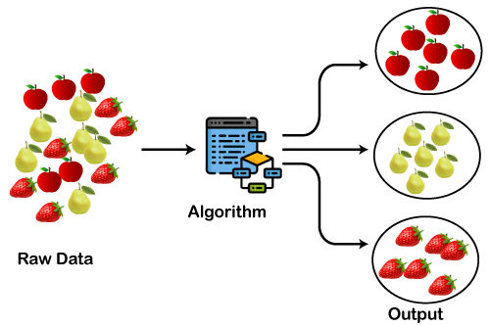
Apart from these general usages, it is used by the Amazon in its recommendation system to provide the recommendations as per the past search of products.
Netflix also uses this technique to recommend the movies and web-series to its users as per the watch history.

Slide 12
Types of Clustering Methods
The clustering methods are broadly divided into Hard clustering (datapoint belongs to only one group) and Soft Clustering (data points can belong to another group also).
But there are also other various approaches of Clustering exist.
Below are the main clustering methods used in Machine learning:
Partitioning Clustering
Density-Based Clustering
Distribution Model-Based Clustering
Hierarchical Clustering
Fuzzy Clustering

Slide 13
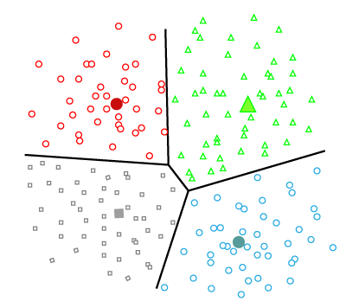
Partitioning Clustering
It is a type of clustering that divides the data into non-hierarchical groups. It is also known as the centroid-based method. The most common example of partitioning clustering is the K-Means Clustering algorithm.
In this type, the dataset is divided into a set of k groups, where K is used to define the number of pre-defined groups.
The cluster center is created in such a way that the distance between the data points of one cluster is minimum as compared to another cluster centroid.

Slide 14
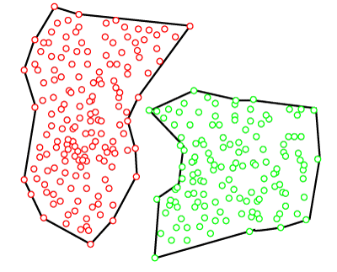
Density-Based Clustering
The density-based clustering method connects the highly-dense areas into clusters, and the arbitrarily shaped distributions are formed as long as the dense region can be connected.
This algorithm does it by identifying different clusters in the dataset and connects the areas of high densities into clusters. The dense areas in data space are divided from each other by sparser areas.
These algorithms can face difficulty in clustering the data points if the dataset has varying densities and high dimensions.

Slide 15
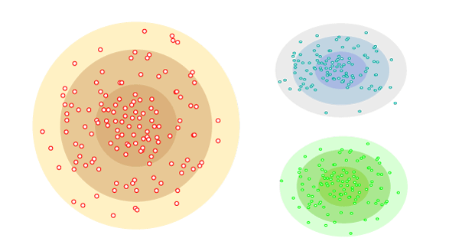
Distribution Model-Based Clustering
In the distribution model-based clustering method, the data is divided based on the probability of how a dataset belongs to a particular distribution. The grouping is done by assuming some distributions commonly Gaussian Distribution.
The example of this type is the Expectation-Maximization Clustering algorithm that uses Gaussian Mixture Models (GMM).

Slide 16
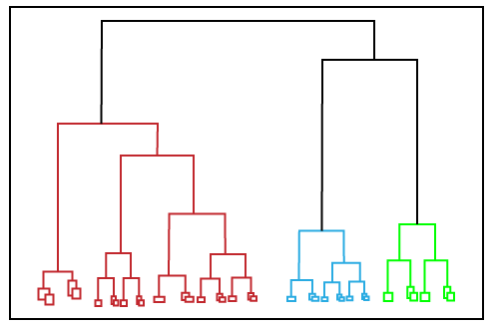
Hierarchical Clustering
Hierarchical clustering can be used as an alternative for the partitioned clustering as there is no requirement of pre-specifying the number of clusters to be created.
In this technique, the dataset is divided into clusters to create a tree-like structure, which is also called a dendrogram.
The observations or any number of clusters can be selected by cutting the tree at the correct level. The most common example of this method is the Agglomerative Hierarchical algorithm.

Slide 17
Fuzzy Clustering
Fuzzy clustering is a type of soft method in which a data object may belong to more than one group or cluster.
Each dataset has a set of membership coefficients, which depend on the degree of membership to be in a cluster.
Fuzzy C-means algorithm is the example of this type of clustering; it is sometimes also known as the Fuzzy k-means algorithm.

Slide 18
Applications of Clustering
Below are some commonly known applications of clustering technique in Machine Learning
In Identification of Cancer Cells: The clustering algorithms are widely used for the identification of cancerous cells. It divides the cancerous and non-cancerous data sets into different groups.
In Search Engines: Search engines also work on the clustering technique. The search result appears based on the closest object to the search query. It does it by grouping similar data objects in one group that is far from the other dissimilar objects. The accurate result of a query depends on the quality of the clustering algorithm used.
Customer Segmentation: It is used in market research to segment the customers based on their choice and preferences.
In Biology: It is used in the biology stream to classify different species of plants and animals using the image recognition technique.
In Land Use: The clustering technique is used in identifying the area of similar lands use in the GIS database. This can be very useful to find that for what purpose the particular land should be used, that means for which purpose it is more suitable.

Slide 19
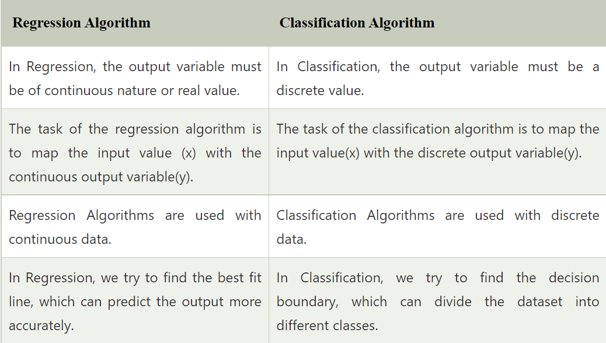
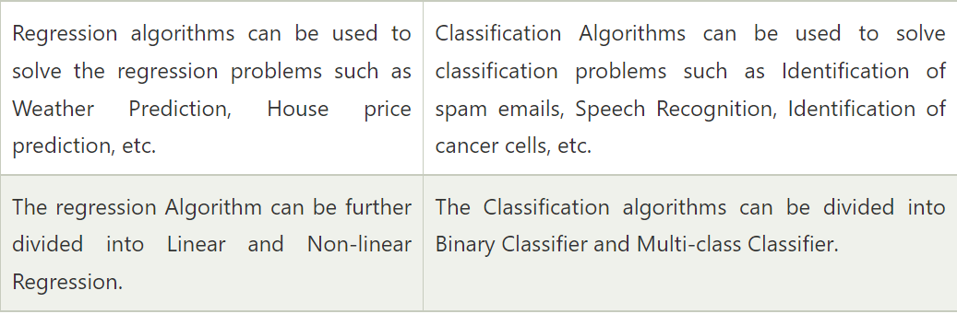

Slide 20
